Slide 1


Slide 2

Tutorial 11 Sections 009/010
TA: Greydon Gilmore
Physiology 2130
Nov 26th, 2019

Slide 3

Your TA reminding you…
2nd Peerwise assignment (1.5%)
Post 2 MC questions: due Nov 27th @ midnight
Answer 5 MC questions: due Nov 29th @ midnight
Valid content: autonomic nervous system, muscle and cardiovascular physiology
2nd Quiz (1%)
Opens: Dec 2nd @ 4pm
Closes: Dec 3rd @ 4pm
2nd Midterm (15%)
When: Dec 19th @ 9am-10am
Room Assignments:
ABBA-GANE: Alumni Hall 15
GHAB-POSA: Alumni Hall 201
PRIM-WOOD: Alumni Hall Stage
WU-ZIA: Somerville House 2316
Review session: Monday Dec 16th from 6-8pm (Auditorium B University Hospital)

Slide 4
Today
Group work activity
Learning Catalytics Question
Cardiovascular anatomy

Slide 5
Group Work

Slide 6
Teach each other the cardiac cycle using the flip chart paper provided! Each member should teach one part of the cycle to the rest of the group.
If you don’t fully understand that’s okay, try your best!
You can refer to your notes
Please take a picture and send me an email:
greydon.gilmore@gmail.com

Slide 7
Cardiac Cycle
Atrial Systole (Atrial Contraction)
P-wave: Atria contract
Pressure: Atria > Ventricles
AV valve already open
Blood (30%) fills ventricles to EDV
Early Ventricular Systole (Isovol. Contraction)
QRS: Ventricles begin to contract
Pressure: Aorta > Ventricles > Atria
AV valve close
No change in volume
Ventricular Systole (Ventricular Ejection)
Ventricles finish contracting
Pressure: Ventricles > Aorta
Aortic valve open
Blood leaves ventricles to ESV
T-wave

Slide 8
Cardiac Cycle
Early Ventricular Diastole (Isovol. Relaxation)
Ventricles relax
Pressure: Aorta>Ventricles>Atria
Aortic valve close
No change in volume
Late Ventricular Diastole (Ventricular Filling)
Ventricles finish relaxing
Pressure: Atria > Ventricles
AV valve open
Blood (70%) fills ventricles

Slide 9
Learning Catalytic Question

Slide 10
The Cardiovascular System: General Function, Organization and Anatomy
Chapter 7: Professor Stavraky

Slide 11
Functions of the cardiovascular system
Transports oxygen and nutrients
Removes carbon dioxide and waste
Regulates body temperature and pH
Transports and distributes hormones throughout the body

Slide 12
Blood volume distribution
Total Blood Volume (TBV) = 5 liters
Heart and Pulmonary circ. = 15%
Systemic arteries/arterioles = 10%
distribution vessels
Systemic capillaries = 5%
exchange vessels
Systemic veins/venules= 70%
capacitance vessels
low pressure, require valves to stop backflow

Slide 13
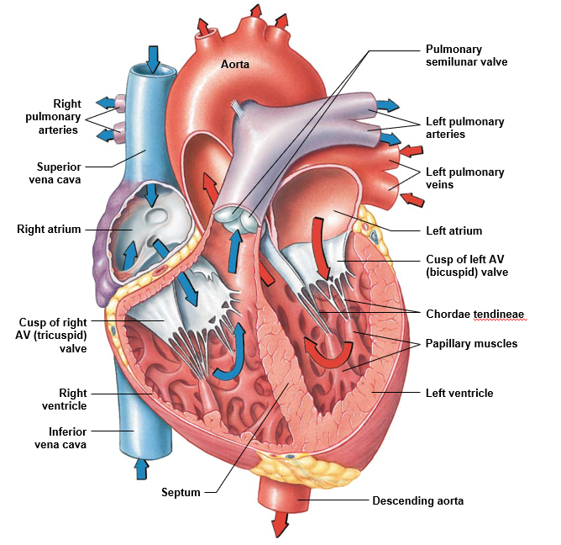
Heart Flow

Slide 14
The _______ supply blood to the heart muscle itself.
coronary arteries
coronary veins
pulmonary arteries
pulmonary veins

Slide 15
The _______ supply blood to the heart muscle itself.
coronary arteries
coronary veins
pulmonary arteries
pulmonary veins

Slide 16
Which of the following is the correct sequence for the spread of cardiac action potentials?
SA node → internodal pathways → AV node → AV bundle → bundle branches → Purkinje fibers
SA node → AV node → internodal pathways → AV bundle → bundle branches → Purkinje fibers
SA node → internodal pathways → AV node → bundle branches → AV bundle → Purkinje fibers
SA node → internodal pathways → AV node → AV bundle → Purkinje fibers → bundle branches

Slide 17
Which of the following is the correct sequence for the spread of cardiac action potentials?
SA node → internodal pathways → AV node → AV bundle → bundle branches → Purkinje fibers
SA node → AV node → internodal pathways → AV bundle → bundle branches → Purkinje fibers
SA node → internodal pathways → AV node → bundle branches → AV bundle → Purkinje fibers
SA node → internodal pathways → AV node → AV bundle → Purkinje fibers → bundle branches

Slide 18
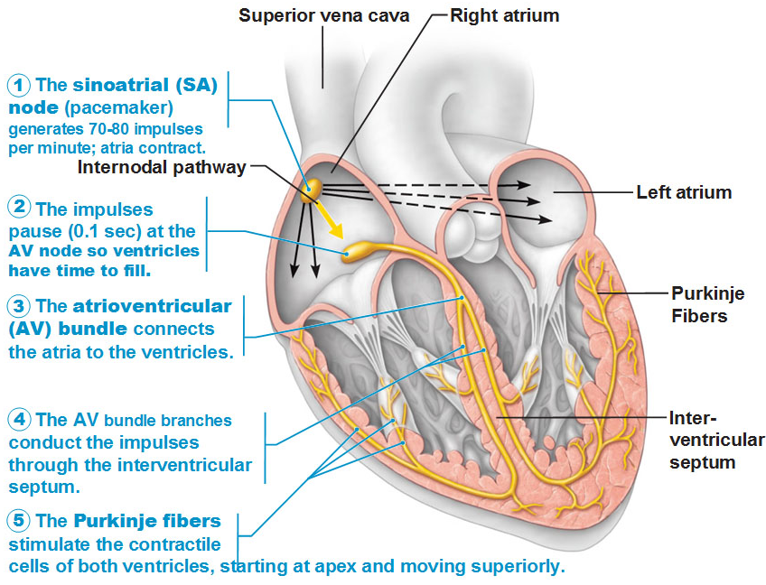
Significance Action Potential Direction
SA Node
Located in right atrial wall below opening of superior vena cava
“Pacemaker” of heart, controlling rate of heart beat
AV Node
Located in interatrial septum (floor of right atrium)
Electrical relay station, slowing the electrical current from SA node by 1/10th of second
This allows atria to contract first, then ventricles
Conducting cells
Interconnect the two nodes and distribute stimulus throughout myocardium
AV Ring electrically isolates atria from ventricles so they contract separately

Slide 19
Significance Action Potential Direction
Significance of AP propagation (p.198):
Allows atria to contract first then ventricles contract
Atria muscles contract from top to bottom to push blood down into ventricles. Ventricular muscles contract from bottom to top in order to eject blood up and into vessels (pulmonary artery and aorta).

Slide 20
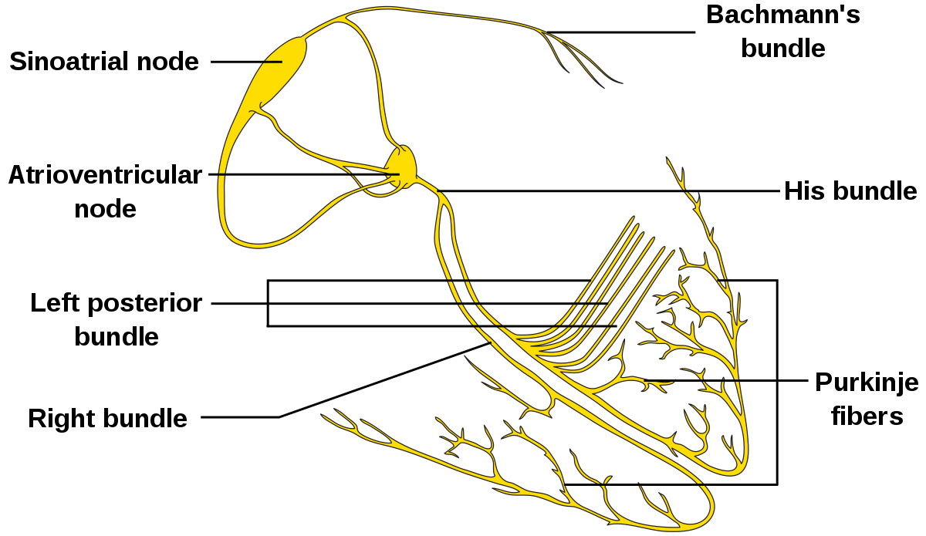
Signal Flow
SA Node: Pacemaker of the heart
How does it generate fast spontaneous APs?
Permeability to Na⁺ and Ca²⁺
Permeability to K⁺
These properties naturally bring the cell to threshold

Slide 21
SA Node Action potential

Slide 22
Compare/Contrast – Action Potentials
 | Action Potential | Cardiac AP
RMP | RMP = -70 mV | RMP = ~-60 mV
Threshold | Threshold = -55 mV | Threshold = -40 mV
Stimulus | Graded Potential | Slow Leak (Na⁺/Ca²⁺)
Depol. Channels | Depolarization = VG Na⁺ | Depolarization = VG Ca²⁺
Repol. Channels | Repolarization = VG K⁺ | Repolarization = VG K⁺
Hyperpol. | Hyperpolarization = Leak channels | N/A

Slide 23
Cardiac Cycle
Atrial Systole (Atrial Contraction)
P-wave: Atria contract
Pressure: Atria > Ventricles
AV valve already open
Blood (30%) fills ventricles to EDV
Early Ventricular Systole (Isovol. Contraction)
QRS: Ventricles begin to contract
Pressure: Aorta > Ventricles > Atria
AV valve close
No change in volume
Ventricular Systole (Ventricular Ejection)
Ventricles finish contracting
Pressure: Ventricles > Aorta
Aortic valve open
Blood leaves ventricles to ESV
T-wave

Slide 24
Cardiac Cycle
Early Ventricular Diastole (Isovol. Relaxation)
Ventricles relax
Pressure: Aorta>Ventricles>Atria
Aortic valve close
No change in volume
Late Ventricular Diastole (Ventricular Filling)
Ventricles finish relaxing
Pressure: Atria > Ventricles
AV valve open
Blood (70%) fills ventricles

Slide 25
Next Tutorial (Dec 3rd)
More Cardio physiology!

Slide 26
What Questions Do You Have?
You can ask in the Owl forums as well!
Also anonymously ask questions in the online dropbox!!

